Slide 1
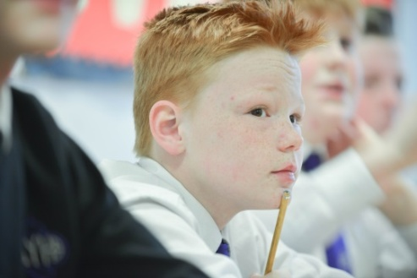
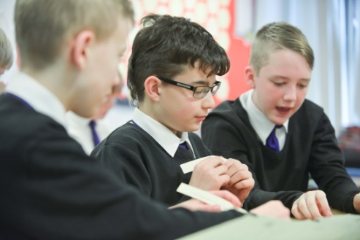
THE JAMES YOUNG HIGH SCHOOL
Senior Phase Information
2023
Supporting your child through National 5 and Higher English

Slide 2
Structure of National 5 and Higher
Folio: 30%
Reading for Understanding, Analysis and Evaluation: 30%
Critical Reading: 40%

Slide 3
Structure of Higher and National 5
Folio:
1 essay worth 30%
Personal/ creative or
Discursive/ Persuasive
Higher: essays should not be longer than 1300 words.
Nat 5: essays should be no longer than 1000 words.
Our deadline for the folio to be completed is Christmas.
First draft October Holidays.

Slide 4
SQA
Your teacher or lecturer may provide reasonable assistance, which could include support in choosing a theme and genre, and advice and guidance on a first draft.
Notes:
Brief as more covered with PTC team later:
Pace; whichever year SP requires commitment and hard work from now
Challenges; there will be challenges in the way; it will get tough but that is when we learn
Resilience; dropping subjects is not an option
Plan for Success - recoursing
Expectations and Aspirations
Personal Achievement; S6 Enhanced Curriculum compulsory for all S6 pupils for 2 periods with substantial choice.
Part time jobs

Slide 5
SQA
Centres should make parents and carers aware of their responsibility in ensuring a fair and reliable assessment. For example, parents and carers could encourage the candidate to spend time on their coursework and to think about it as early as possible. They could discuss the planning and timing of the work. Teachers and lecturers could encourage parents and carers to provide the candidate with access to resource materials and discuss the coursework with them. However, they must be made aware that they must not give direct advice on what should or should not be included.

Slide 6
Creative/Personal Writing Checklist
Do you have…?
Similes
Metaphors
Personification
Adjectives
Varied vocabulary
Varied sentence types/ lengths
Sensory description
Reflection
Clear personality/character voice
Clear structure

Slide 7
Personal/ creative
Taking shaky breaths, she stopped to think. Darkness hung in the air like a spell, broken by the warm glow of lights along the bridge. Her knuckles were white; the railing was her lifeline. One moment of weakness or fault in her grip; and she’d fall. And she wanted to. So why hadn’t she jumped? Or simply fell? She attributed it to how she found solace in this place alone. Slowing down to think was not a luxury she could often afford, and as such this was a rare occurrence. Her auburn hair fell onto the back of her neck, some at her chest and other strands in a ruined mess atop her hair as the howling wind finally died down. Instinctively, her hand went up to fix her hair in three broad and practiced swipes.
Example of Nat 5 work

Slide 8
With ten minutes to play the deficit had opened again to a cavernous five points, and the atmosphere inside the stadium was electric. A series of tense collapsed scrums augmented the atmosphere as it looked like Scotland had their backs to the wall. Yet, in a series of agile plays, Scotland charged into the Australian 22 and under the towering posts to put us two points clear. Five minutes to play. I was elated. In spite of the domineering strength of Australia throughout the second half, plucky underdogs Scotland had brought it back and now led arguably one of the best teams in world rugby. Surely it was now all over? Obviously, Scotland thought so too as they faffed about with a series of resets, playing blindly as they tried to hold on into dead time. They couldn’t. With just thirty seconds to play another contentious decision for a knock on came from the beleaguered South African official, and the Aussie’s were kicking for goal. From just outside the 22, a cold and calculated kick meant that Australia had secured their Coup de grâce. Scotland had lost. Breathless from the pace of the dying minutes of play, I slumped in my seat crushed that victory had been taken from the grasp of deserving winners.
Example of Higher work

Slide 9
Persuasive essays
 | TECHNIQUE | WHAT? | EFFECT?
A | ALLITERATION | Repetition of consonant sounds / words beginning with the same letter. | Creates an interesting rhythm that makes the word/phrase stand out/stick in your head.
F | FACT | Something you can prove. | Providing real, documented evidence makes your argument more convincing.
O | OPINION | One person’s point of view. | Opinions can be very plausible, believable and draw us in. They are often mistaken for facts.
R | RHETORICAL QUESTIONS | A question that does not require an answer. | Encourages the reader to think about what is being argued. The questions lead the reader to reach the same conclusions.
E | EMOTIVE LANGUAGE | Verbs that give commands. Adjectives that appeal to the readers emotions. | Powerful verbs often demand a response from the reader forcing them to think. Emotive adjectives are used to provoke a strong reaction to the issue.
S | STATISTICS | Figures and percentages from professional studies/research. | Adds factual depth and weight to an argument.
T | TRIPLES (rule of three) | When words or phrases are repeated three times. | Repeating things three times is psychologically proven to aid memory. Putting words or phrases into groups of three creates a memorable rhythm that is easy to remember.
E | EXAGGERATION | Statements that are blown out of proportion. Things are made to seem bigger/smaller/better/worse than they really are. | Exaggerating draws attention to the issue under discussion and captures the reader’s attention. It can help convince people to think about the seriousness of the issue.
R | REPETITION | Words or phrases that appear more than once throughout. | Repetition is an effective way to draw attention to important points. You can repeat words, phrases, sentence structures, ideas and techniques – all are powerful ways to emphasise your point.

Slide 10
Persuasive essays
Well, they do. Some senior managers of hospitals have wanted to close down the unhealthy outlets and replace them with healthier options suited to a hospital but in order to accomplish that they would have to pay the contractors to agree with these changes. For example in order to close down a burger chain, Croydon Healthcare trust had to pay £24,000. Now, it is quite well known that in recent years the NHS has not been doing very well financially. Since 2013, their end-of-year financial results have dropped dramatically and is now sinking below an uncomfortable -£2.5 million, with the amount they are expected to spend continuously on the rise.
Example of National 5 work

Slide 11
Persuasive essays
In the last year, several high-profile cases have involved the use of a Taser. In Leytonstone, a terrorist who had attempted to behead a member of the public was arrested using a Taser, halting his rampage in less than 5 seconds. In Greenwich, another terrorist was arrested with the use of a Taser after planting a bomb on a London Underground train, ensuring that no danger from an explosion of a suicide vest was transferred to innocent bystanders. In 2013, an armed 15-year-old was prevented from entering a primary school in Bannockburn after he was struck with a Taser. There is no doubt that Tasers have prevented countless atrocities and saved many lives, and to continue to protect our communities we must roll out Taser to every officer in Scotland.
Example of Higher work

Slide 12
Folio workshops N5
Thursday lunchtime
When | Where
Thurs 21 Sept, 1.10 | Room 4 English
Thurs 12 Oct, 1.10 | Room 4 English
Thurs 26 Oct, 1.10 | Room 4 English
Thurs 9 Nov, 1.10 | Room 4 English
Thurs 23 Nov, 1.10 | Room 4 English
Thurs 7 Dec, 1.10 | Room 4 English

Slide 13
Folio workshops Higher
Thursday lunchtime
When | Where
Thurs 28 Sept, 1.10 | Room 4 English
Thurs 19 Oct, 1.10 | Room 4 English
Thurs 2 Nov, 1.10 | Room 4 English
Thurs 16 Nov, 1.10 | Room 4 English
Thurs 30 Nov, 1.10 | Room 4 English
Thurs 14 Dec, 1.10 | Room 4 English

Slide 14
RUAE
National 5: read a passage and answer questions
Higher: read 2 passages, answer questions on the first passage and then answer a question comparing the two passages

Slide 15
What is being tested?
Understanding of the passage (in your own words)
Sentence structure/ punctuation
Word choice/ context
Imagery
Tone
Linking ideas
Comparison of two passages

Slide 16
RUAE (30% of the final mark)
Read and summarise newspaper articles/ discuss the techniques used within the articles
National 5 and Higher RUAE homework booklets
SQA past papers
Achieve
Scholar

Slide 17
Critical reading (40% 0f the final mark)
There are two parts to this exam paper:
Scottish set texts
Critical essay

Slide 18
Critical reading (40% of the final mark)
Scottish set Texts
6 poems / short story/ play
1 poem/ extract will be provided in the exam and there will be 5 questions on it
The final question will ask the candidate to compare the given poem to at least one other (8 marks for Nat 5 and 10 for Higher)

Slide 19
Critical reading
Scottish set texts
Learn the annotation of the poems/ story
Learn the themes that link the poems and ideas to support
SQA past papers
BBC bitesize

Slide 20
Critical Reading
Critical essay
The candidate will be asked to answer an unseen question on the text they have studied in class.
This will be prose, prose non fiction, poetry, media or drama (not the genre of the Scottish text).

Slide 21
Critical reading
Plan essays using the P.E.E.L. structure.
Point
Example (quote/ specific scene)
Explain (analyse the example)
Link (link ideas back to the question)

Slide 22
Critical reading
Learn key quotes/ examples
Re read the text
Write some essays in the 45 minutes allowed
Check for technical accuracy

Slide 23
Timeline
Oct – first draft of folio
Nov – pre prelim (Scottish set text)
Dec – final draft of folio
Dec – RUAE prelim
Jan - Critical reading prelim

Slide 24
Achieve
Scholar
BBC bitesize
SQA past papers/ website
Teams
Folio workshops
Study sessions
Study planning – starting now
Learner conversations
Meet deadlines/ pre prelims
Get in touch

Slide 25
Young Person
School
Home
Success
Notes:
Model for success is everyone working together. We hope Show My Homework will strengthen this – your ability to be very clear on homework tasks set as well as deadlines.

