Slide 1
The James Young High School
Snr Phase Information Evening
Barry Whelan

Slide 2
Presentation Outline
Course Structure and Pathways at Snr phase
Overview of Content of each course
Digital Learning Resources / Extra Support
Attitude and Homework Expectations
Supporting at Home

Slide 3
The maths journey
BGE 4th level secure. N4 units complete
N5 maths
Higher Maths
Advanced Higher
N5 Applications of maths
Higher Applications of Maths
BGE 2/3rd level
N3/4 Maths /Applications of maths
EXIT POINT
Notes:
Creating another pathway for the pupils to achieve a national 5
The course is challenging and put pupils numerical skills to the test with both formal non-calculator and calculator exam at the end of the year.
The sole purpose of N5 maths is to prepare student to access Higher maths not function in the real world. N5 apps allows students to enter the world of work confidently.
David walkins has compiled a list of courses that accept N5 apps at university level, Nursing, teaching (excluding STEM subjects) this was shared on the Scottish maths teachers FB page which you should join if you are not already a member of.

Slide 4
National 4 Maths and Apps
National 4 courses are internally assessed.
3 units plus Added Value
Students get once test and one resit for each unit. A pass is obtained if pass is gained in each of 3 units plus the added value.
Students in these classes also aim to obtain N5 Numeracy as an extension and preparation for N5 Apps.

Slide 6
Download the Complete Scheme of Work from this link : Level 4/Nat 4 to N5 Pathway

Slide 7
National 5 Maths and Apps
National 5 course award is completely decided on Final Exam Award
No internal assessment contributes to the grade
Grades A to D
Major Assessment in October ( Exam Standard , P1 and P2).
Prelim in January ( P1 and P2)
March ( Final Exam Content )

Slide 8
Topics in N5 Math’s and Applications
Math's or Applications
Nat 5 Math's
Ratio
Nat 5 Apps .
Trig Equations
Surds
Probability
Similarity
Rounding
Tolerance
Indices
Percentages
Fractions
Budgeting
Brackets & Factorising
Changing the subject
Perimeter
Best Deals
Pythagoras
Currencies
Vectors
Compound Interest
Box Plots
Algebraic Fractions
Standard Deviation
Precedence
Tables
Gradient
Circle Theorems
Speed , Distance , Time
Volume
Quadratics &
Parabolas

Slide 10
Download the Complete Scheme of Work from this link : Level 4/Nat 4 to N5 Pathway

Slide 11
Higher Maths
Higher Maths course award is completely decided on Final Exam Award
No internal assessment contributes to the grade
Grades A to D
Major Assessment in October ( Exam Standard , P1 and P2).
Prelim in January ( P1 and P2)
March ( Final Exam Content )

Slide 12
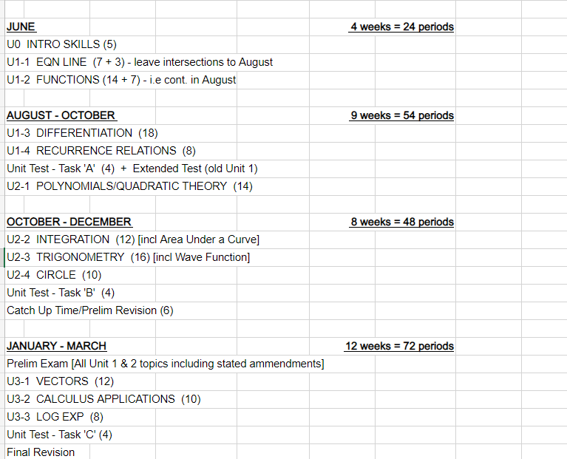
Link to Higher Scheme of work – Higher

Slide 13
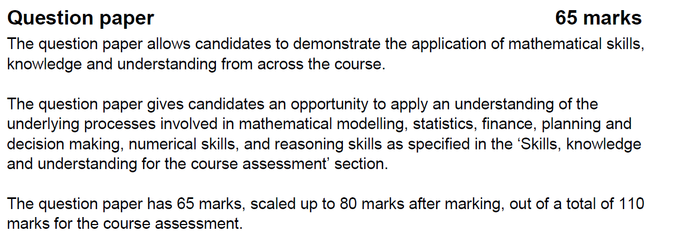
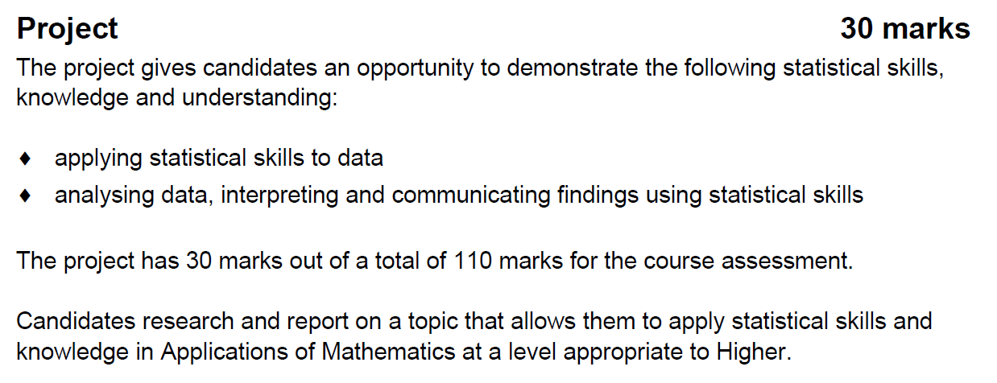
Higher Apps

Slide 14
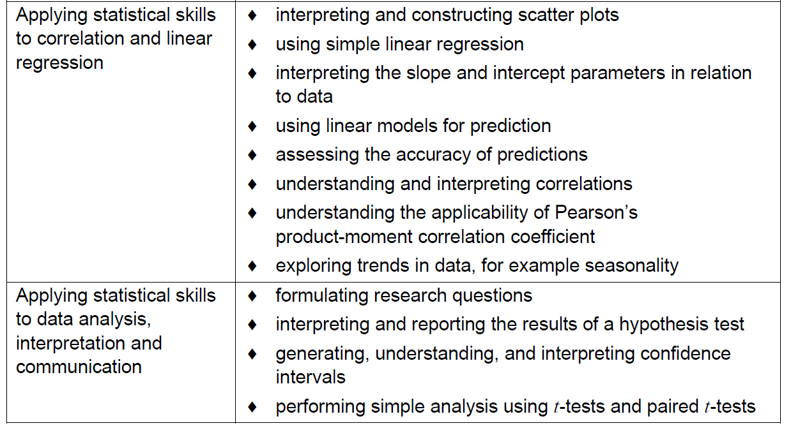
Higher Apps

Slide 15
Adv Maths
Adv Maths course award is completely decided on Final Exam Award
No internal assessment contributes to the grade
Grades A to D
Major Assessment in October ( Exam Standard , P1 and P2).
Prelim in January ( P1 and P2)
March ( Final Exam Content )
Encourage higher students to take this in s6, very strong record at school

Slide 16
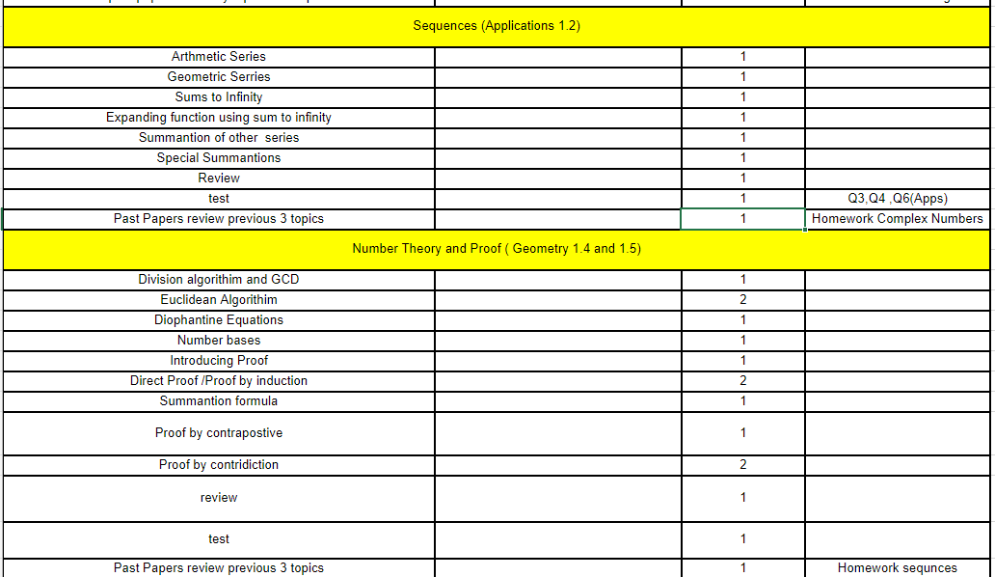
Link to Adv Scheme of work – Adv H

Slide 17
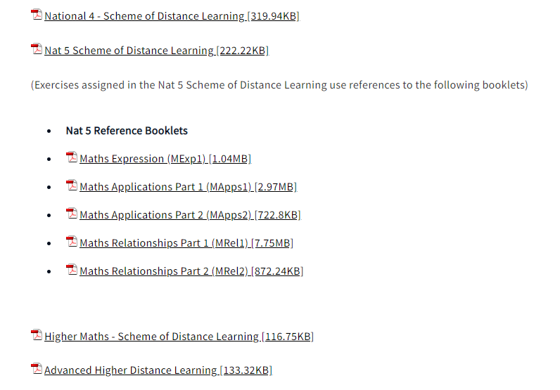
Link to website to download distance learning materials – Website Link

Slide 18
One Drive Links
National 5
Higher
Adv Higher

Slide 19
After School Support
Nat 5 – Thursday Mr Whelan , Wednesday Lunch Mr Whelan
Nat 5 Apps – Thursday Mrs Edwards
Higher – Mrs Mulholland Thursday after school.
Higher Apps – Tuesday after school.

Slide 20
Attitude and Expectations
Encourage a positive attitude about maths
Encourage them to agents of change and take personal responsibility , take advantage of the extra classes and online support.
All Students need a calculator.
HW should be given to all students at least one per week, HW will average from 45 minutes to 1 hour each week.
Beware the Dangers of phone use and social media especially in the run up to assessments.
High Attendance is key , number one indicator in research study in England for obtaining 5 good GSCE was attendance above 95%.

Slide 21
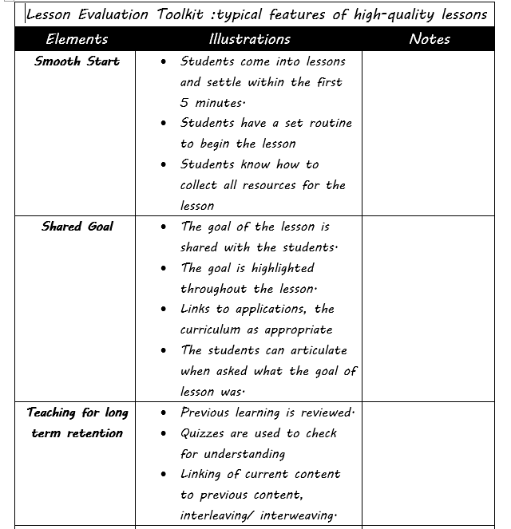

Slide 22
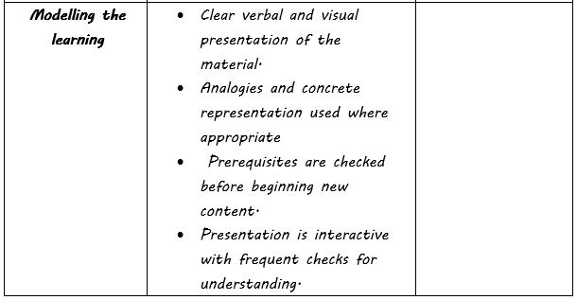
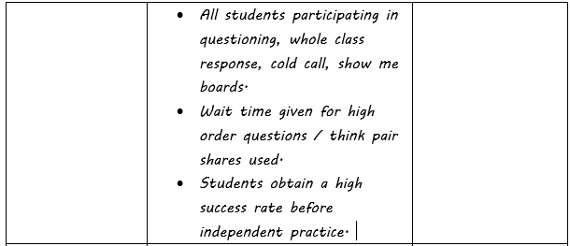

Slide 23
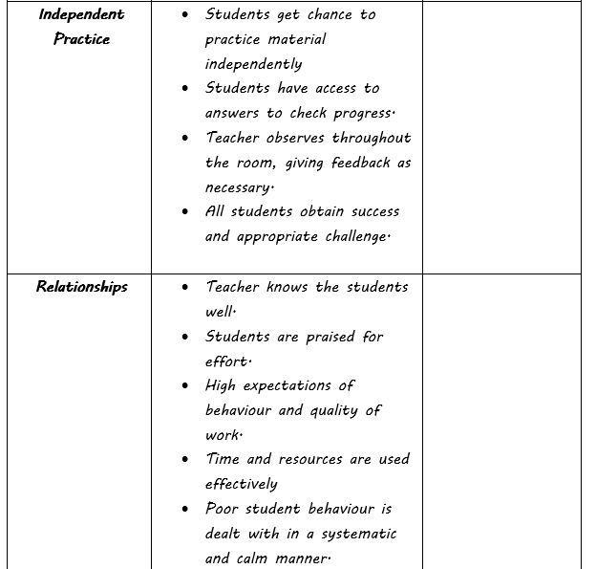

Slide 25
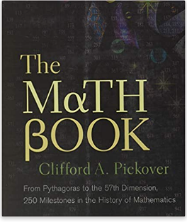
Wanting the Extra Push
Recommend Textbooks for extra work at home
Podcasts : Curious cases of Rutherford and Fry
Numberphile

Slide 26
Questions Please

